Slide 1
A Study Of The Book Of Revelation
March 1, 2020

Slide 2
Theme Of The Book
Will the kingdoms of men in fact be able to abolish the kingdom of God?
Will the kingdom of God stand forever? cf. Daniel 2:44
The answer was clearly revealed: Jesus Christ is “Lord of lords and King of kings,” and he will ultimately prevail.

Slide 3
Theme Of The Book
Revelation 17:14, “These will make war with the Lamb, and the Lamb will overcome them, for He is Lord of lords and King of kings; and those who are with Him are called, chosen, and faithful.”

Slide 4
To Whom Was It Written?
Seven churches of Asia. (1:4, 10, 11)
Not restricted to those seven.
Others in Asia: Troas (Acts 20:7); Colossae (Colossians 1:2), and Hierapolis (Colossians 4:13)
Perhaps seven is symbolic of all the churches.
Why these seven?
Christians in all ages can benefit. Universal in application.
Revelation 1:3 – “he that reads …”
Revelation 22:17-18 – “everyone who hears …”

Slide 5
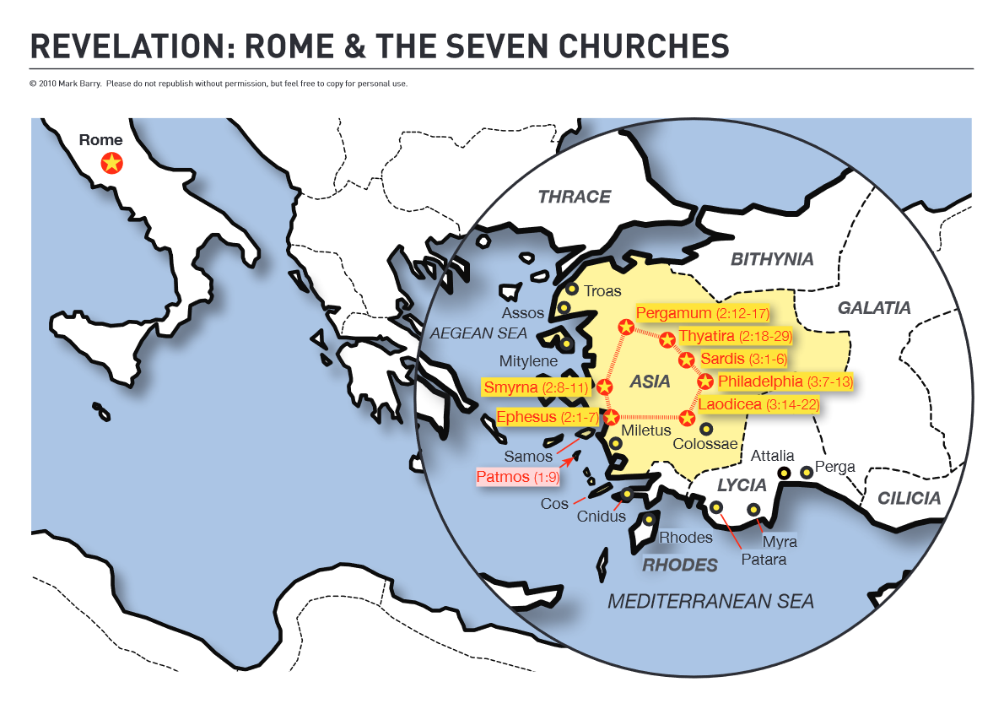

Slide 6
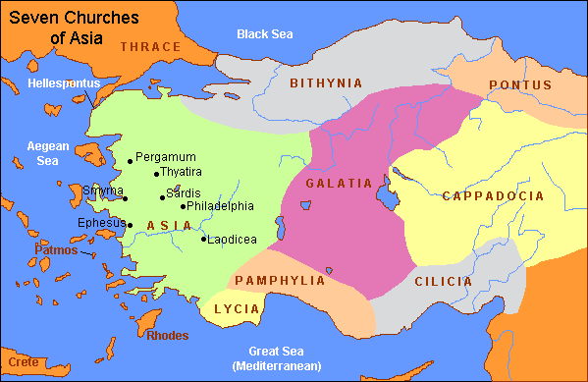

Slide 7
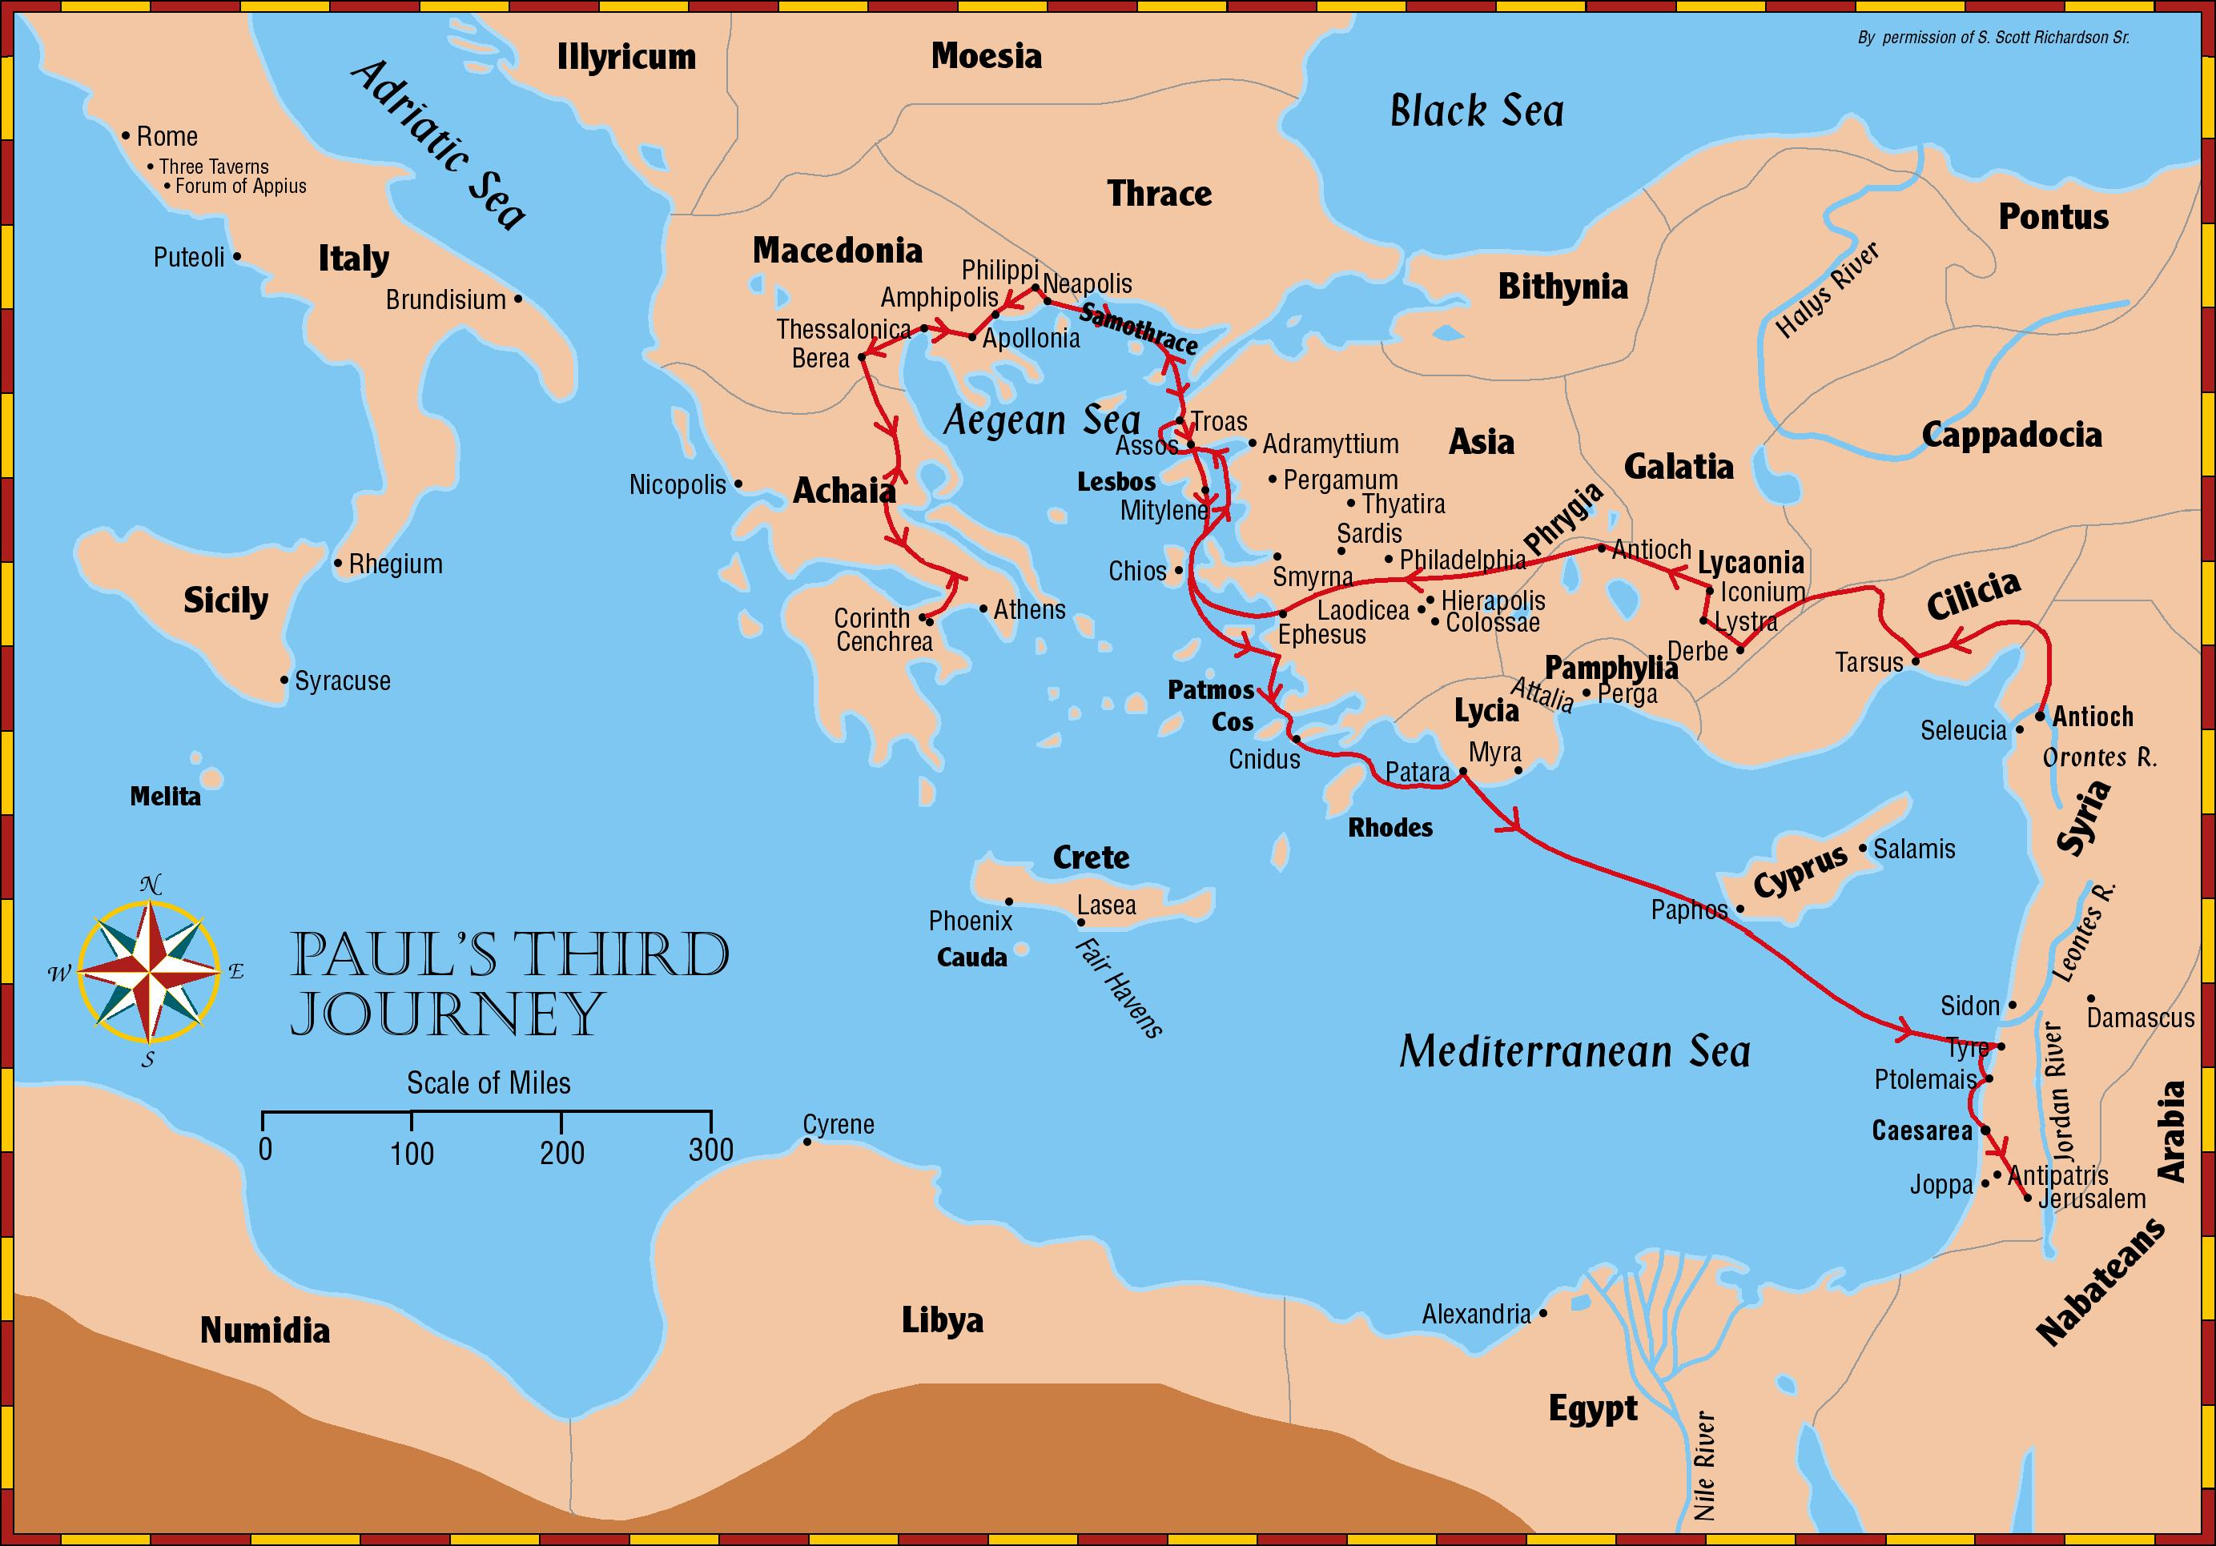

Slide 8
The Author – John
Text says it was John. (1:1; 4:9; 22:8)
Was this John the apostle and brother of James, the son of Zebedee? Or was it John Mark, the young man who accompanied Paul and Barnabas on their first preaching journey? Or was it still a different John known only by tradition as an elder of the church at Ephesus? Or did some other writer use the name John as a pseudonym?
External evidence indicates John the Apostle.
Early writers (i.e. Irenaeus, Clement of Alexandria, and Tertullian) say it was John the apostle.

Slide 9
The Author – John
Text says it was John. (1:1; 4:9; 22:8)
Internal evidence indicates John the Apostle.
Jesus is called “the Word” in John 1:1 and Revelation 19:13 and nowhere else in Scripture.
Only in these two books is Jesus called “the Lamb” (John 1:29, 36; Revelation 1:8, 12-13, etc. ) and is it said that he had been “pierced” (John 19:34-37; Revelation 1:7)
The phrases, “keep my word” and “keep my sayings” are common to John’s writings, but are not elsewhere found in the New Testament.
NOTE: God in Christ is the real author. It is not “John’s apocalypse,” but God’s.

Slide 10
Facts About John
John the Apostle.
Son of Zebedee (Matthew 27:56; Mark 15:40-41).
Close with Jesus.
One of only three disciples at the raising of Jairus’ daughter (Mark 5:37; Luke 8:51).
Present at the transfiguration (Matthew 17:1-13), and at Gethsemane (Matthew 26:36-45).

Slide 11
Facts about John
He was the disciple whom Jesus loved. (John 21:20).
He was at Jesus’ bosom at the supper (John 13:23; 21:20ff).
Jesus committed His mother’s care to him. (John 19:25-27)
John wrote 5 New Testament books:
The gospel of John, the three epistles, and Revelation.

Slide 12
Where Written: Patmos
John said he was on the island of Patmos. (1:9)
60-70 Miles Southwest of Ephesus / 24 miles West of the shore of Asia.
About 10 miles long and 6 miles wide.
A rocky island.
John banished to the island due to persecution.

Slide 14
Methods of Interpretation
Futurist Method
Continuous – Historical Method
Philosophy of History Method
Preterist Method
Historical – Background Method

Slide 15
Methods of Interpretation
FUTURIST METHOD – Premillennialism
Chapters 1-3 Fulfilled already.
Chapters 4-19 as being future. They will be fulfilled just before the Second Coming of the Christ.
Chapter 20:1-10 the (millennial reign of Christ on earth) 1,000 years and then the loosing of Satan (the millennial ends in failure)
Chapter 20:11-15 the judgment, then the final state.
This theory is rejected, for it is contradictory to all of the teachings of the Old Testament prophets concerning Christ’s reign as King (cf. Daniel 7:13-14; 1 Corinthians 15:24). Christ is not coming to set up a kingdom, rather to deliver the Kingdom to God.

